Slide 1
Human Information Processing
- The study of Human thought and behavior

Slide 2

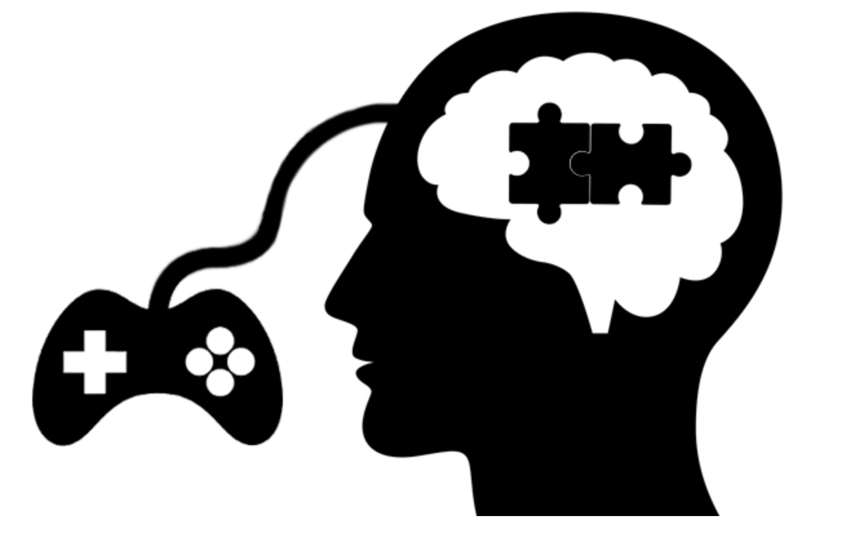
GAMING
The Psychology Behind
Presented by:
Sandeep Keshav
Shruti Gupta
Debdas Ghosh
Piu Mallick

Slide 3


SHOCKING STATISTICS
Is the statistics
pointing
towards
you?
49% of the school going children play video games.
Average age of men and women playing video games is approximately 33 years.
The older adults will be the ones who will be indulged more into video games in the next 30-40 years.

Slide 4
How can rewards affect gaming experience?

Slide 5

Rewards (r/)
Rewards and motivation
Rewards and feedback
Rewards and conditioning
Reward timing
Rewards and control
Rewards and cognitive bias

Slide 6
r/Motivation
Intrinsic Motivation - Personal Gratification
Extrinsic Motivation - External Feedback

Slide 7
r/Feedback
Did I get a reward?
Why did I get it?
Is my reward really a reward?

Slide 8
Are Rewards always rewarding?

Slide 9
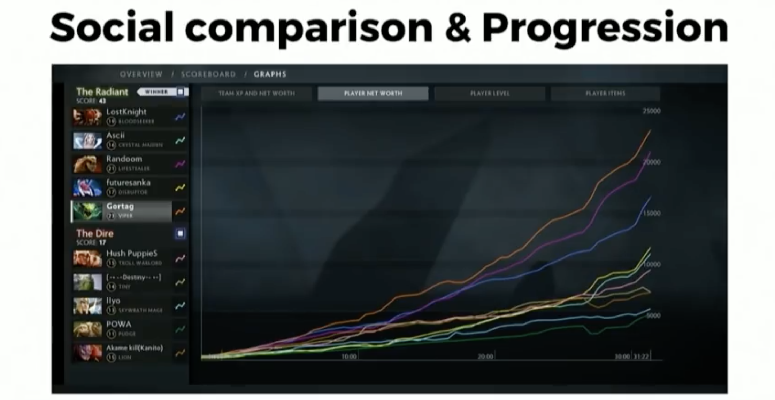

Slide 10
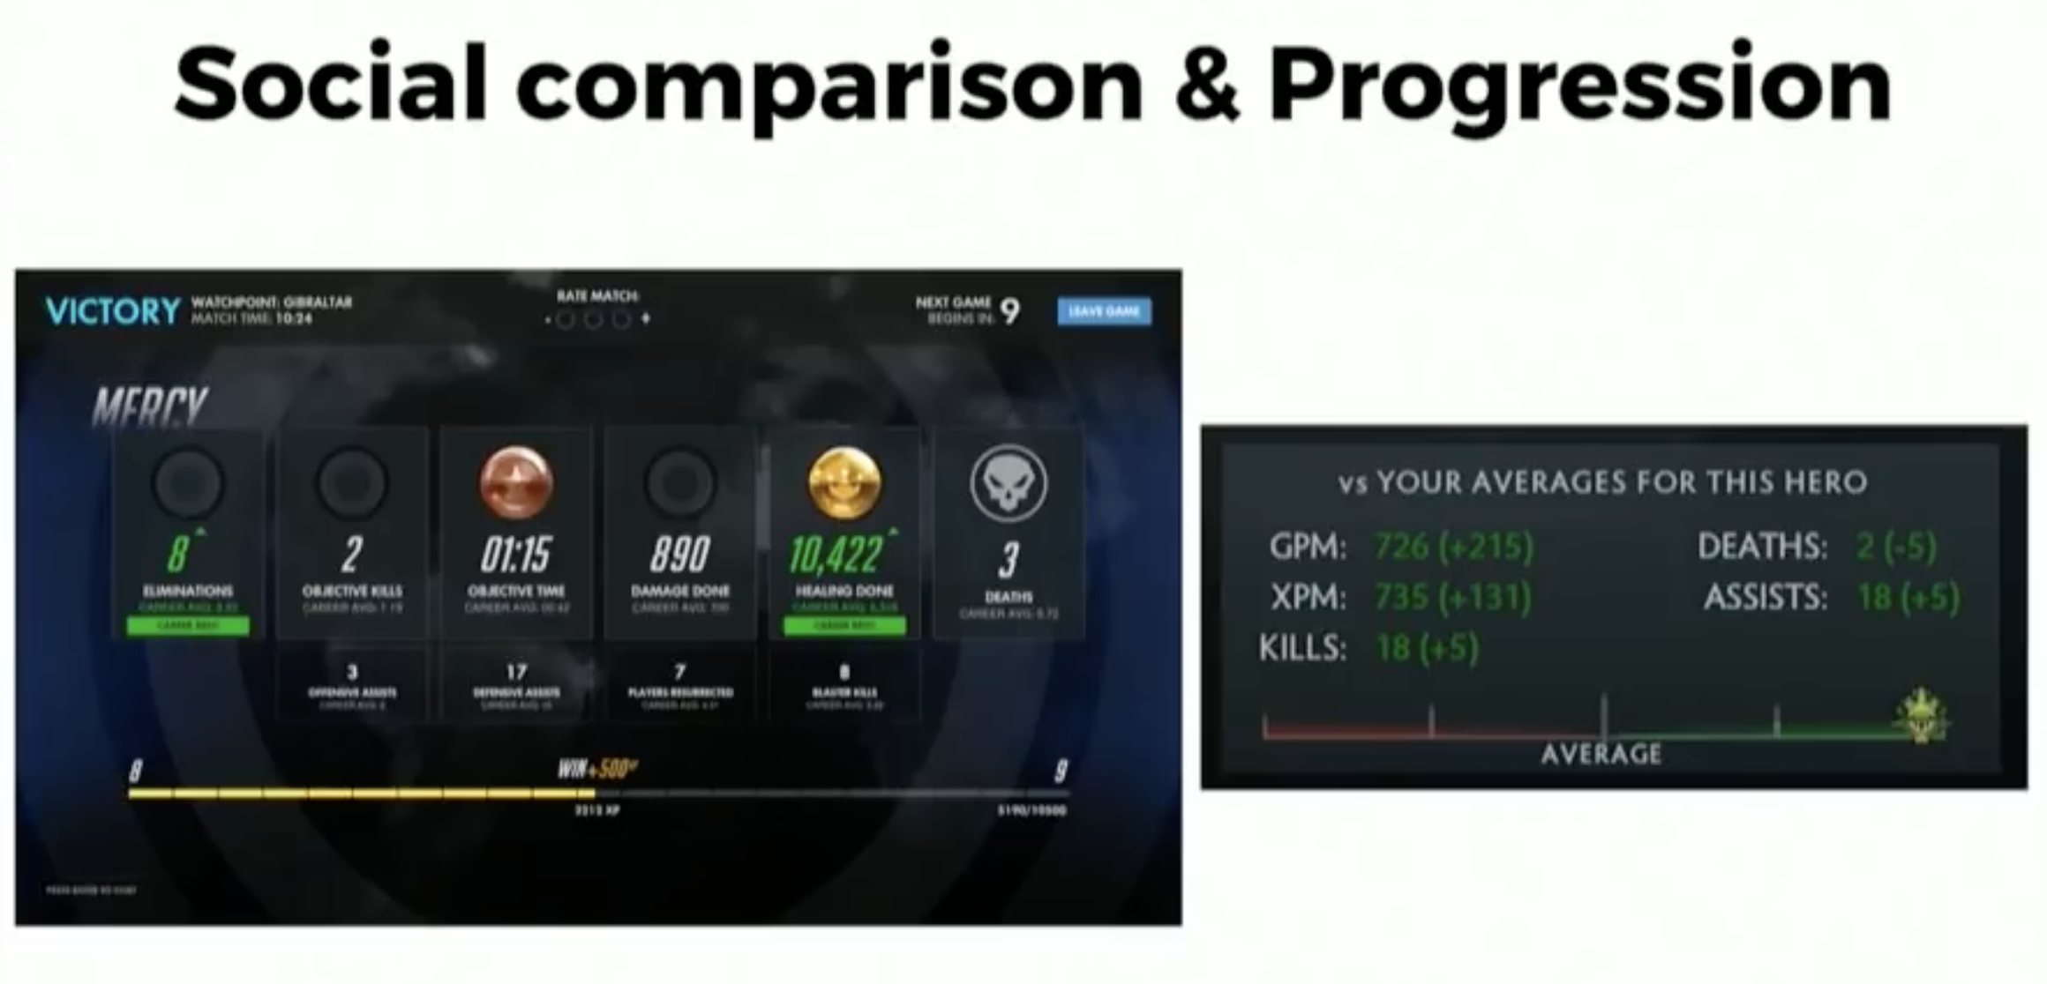

Slide 11
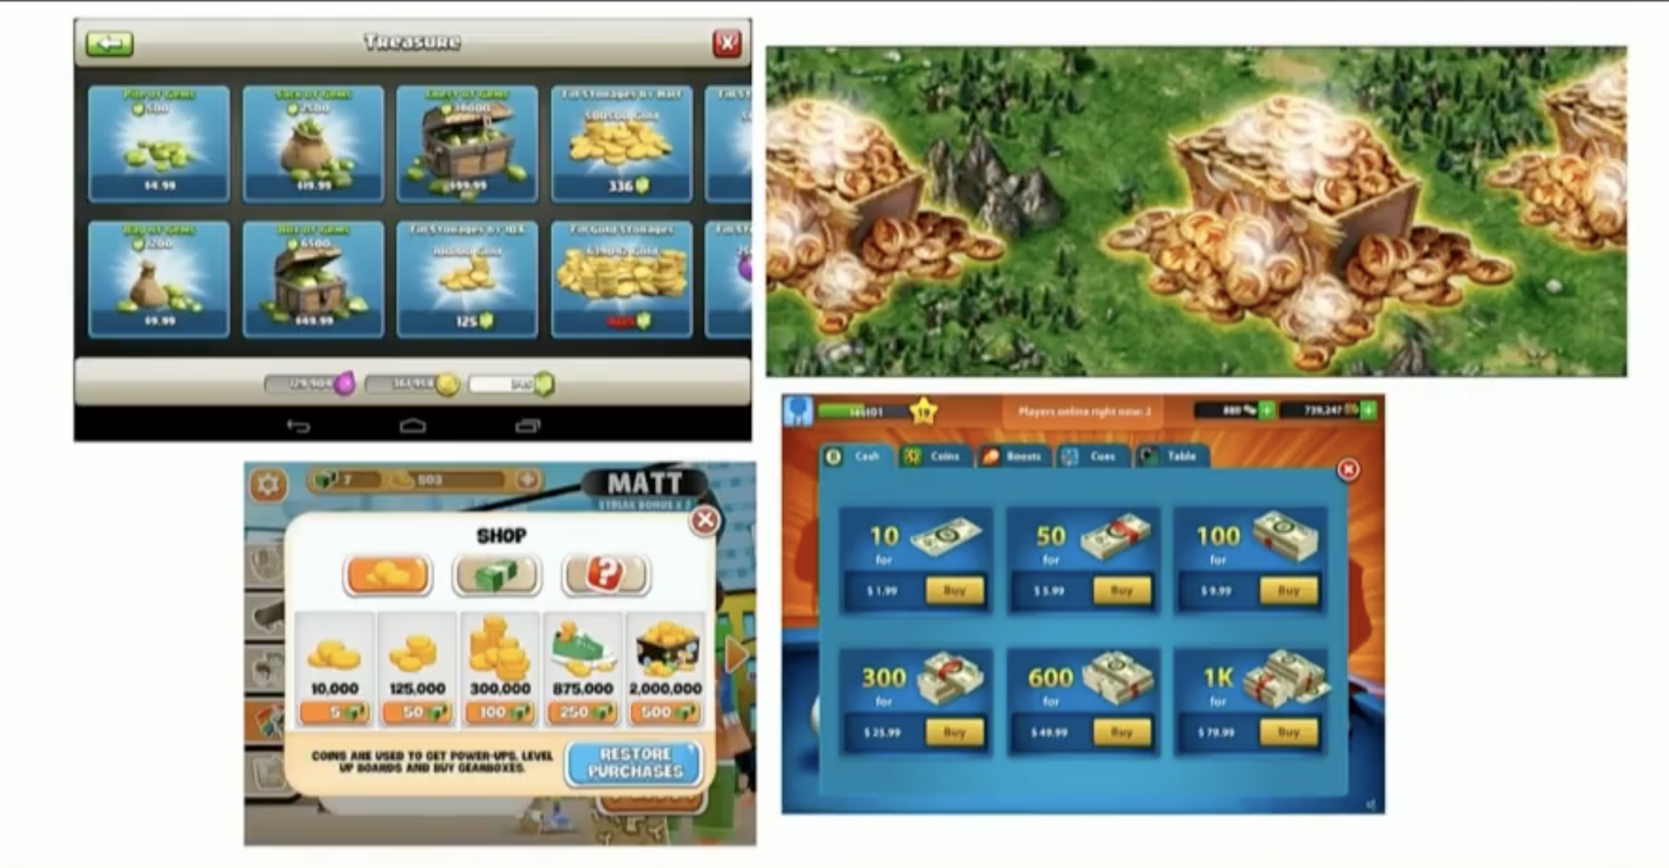
Classical Conditioning (Pavlov)

Slide 12
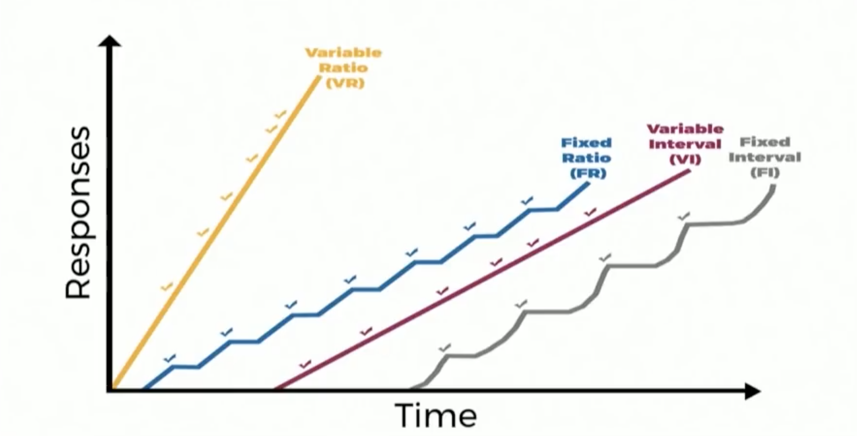
Operant Conditioning (SKINNER)
Fixed Ratio
Fixed Interval
Variable Ratio
Variable Interval

Slide 13
r/Timing
Long Term Goals
Short Term Feedback
Unexpected Surprises

Slide 14
r/Control
Control
Counter-control
Illusion of control

Slide 15
r/Cognitive Biases
Representativeness Heuristic
Time
Cost
Effort
Streak
Probability rewards

Slide 16
r/Summary
Reward Behavior
Mix guaranteed with Unexpected
Illusion of Control
Value of Rewards
Social Comparison
Progression
Understand, Set, Meet, Exceed

Slide 17

Motivation
INTRINSIC
EXTRINSIC

Slide 18
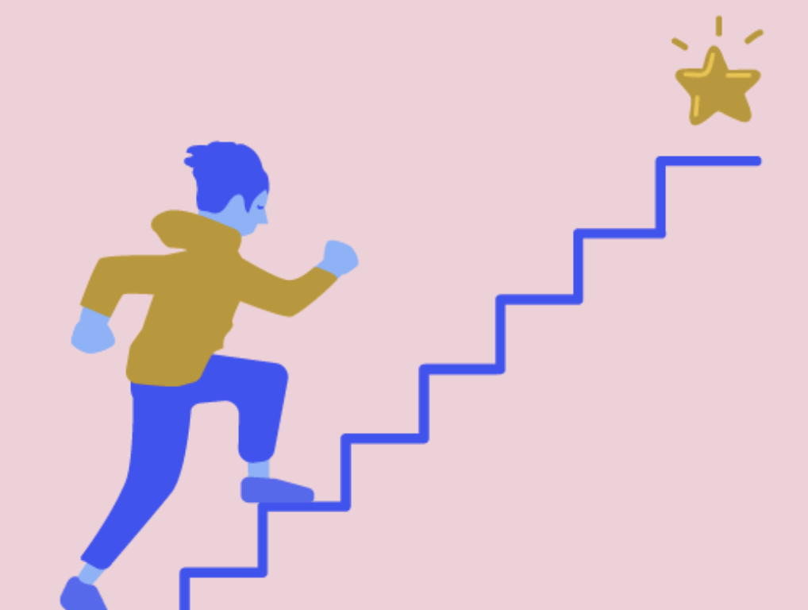

NEAR MISSES
“I’m not failing, I’m almost succeeding.”

Slide 19


COMPLETIONISM
RPG Games

Slide 20
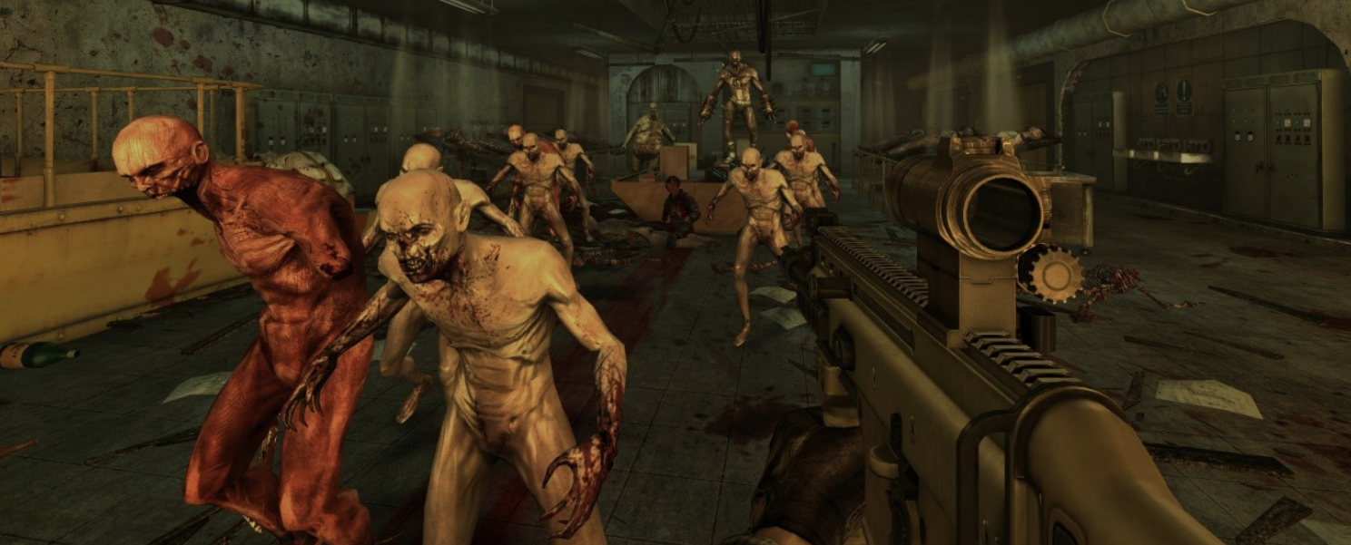
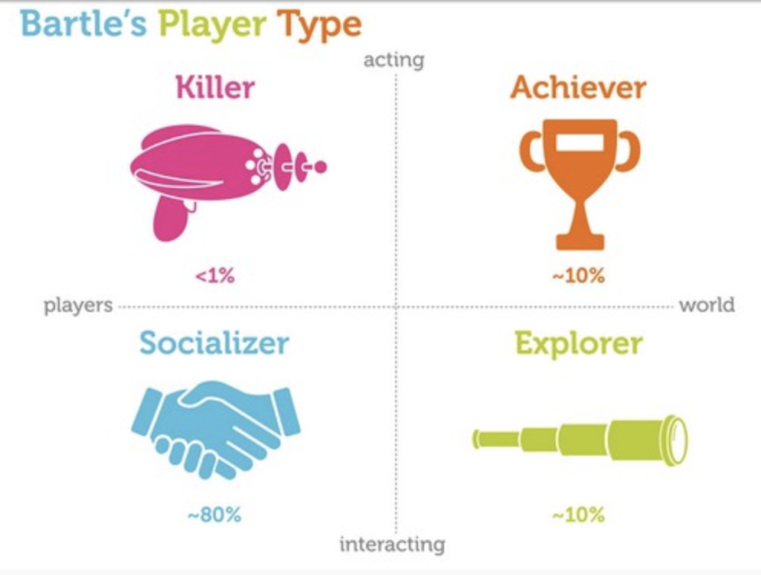
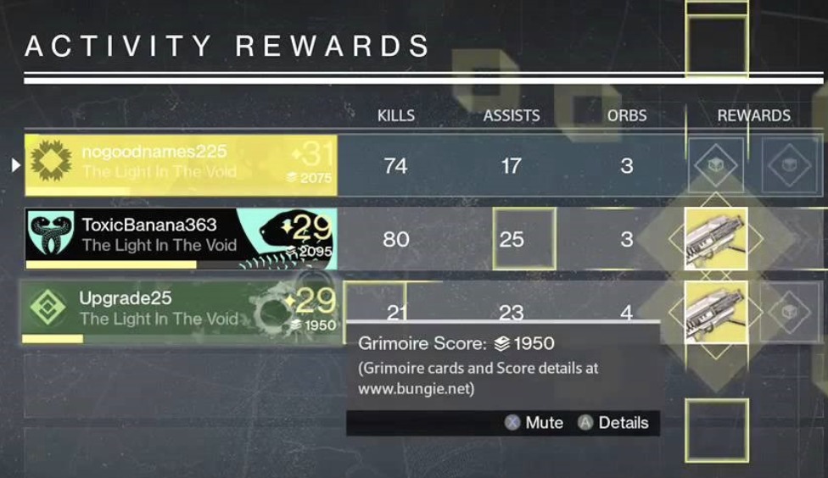
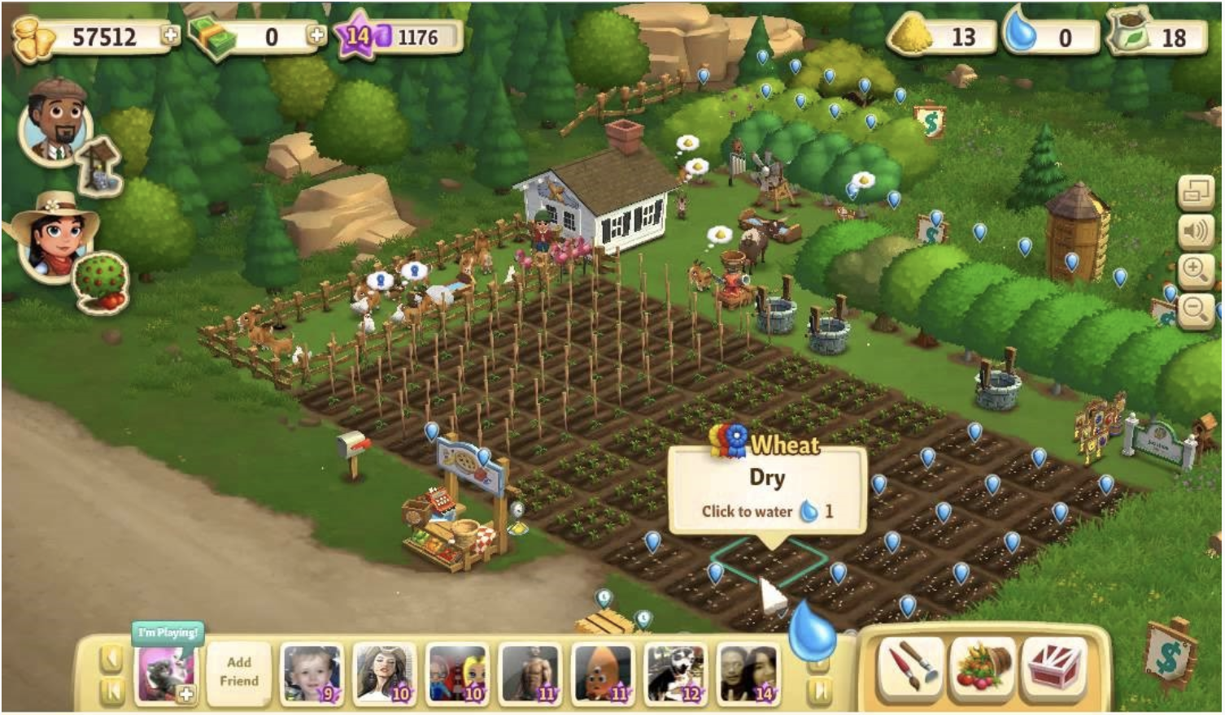

PLAYER TYPES

Slide 21


Slide 22
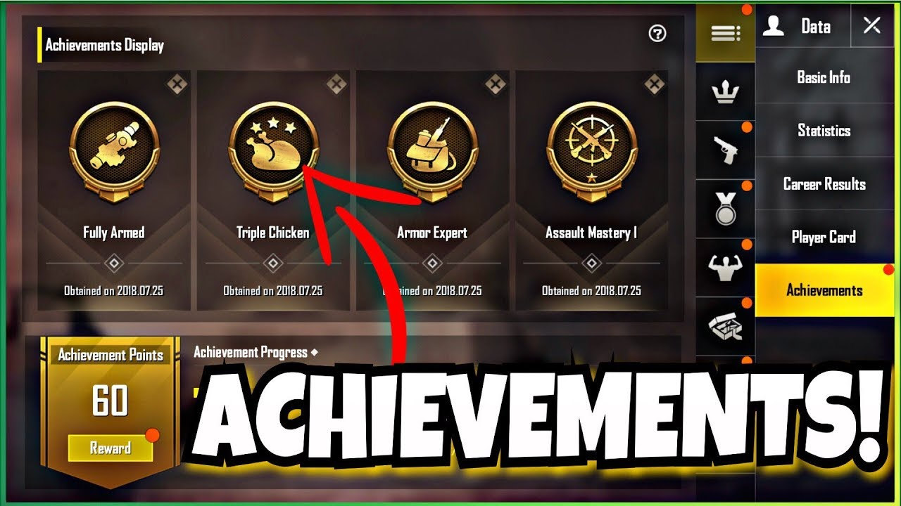

Achievement
PUBG Mobile

Slide 23
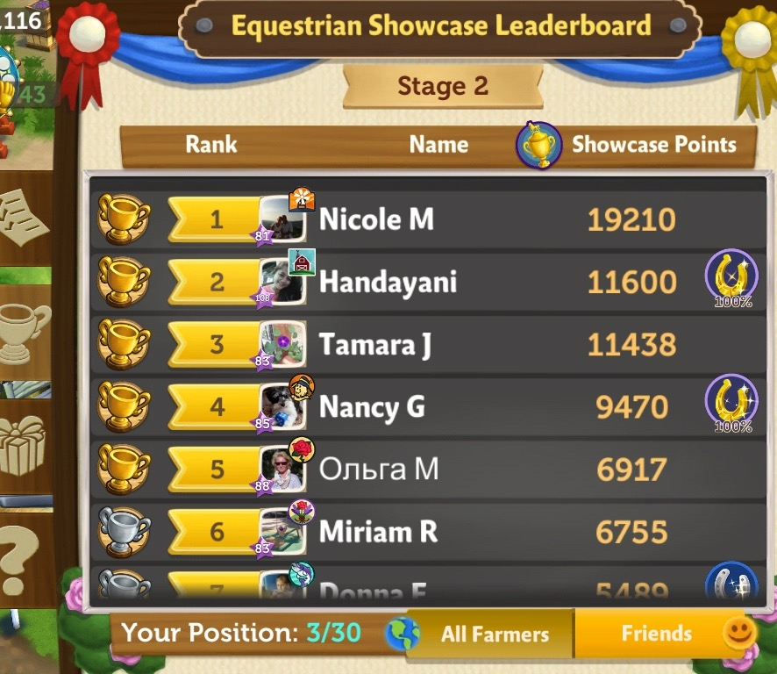
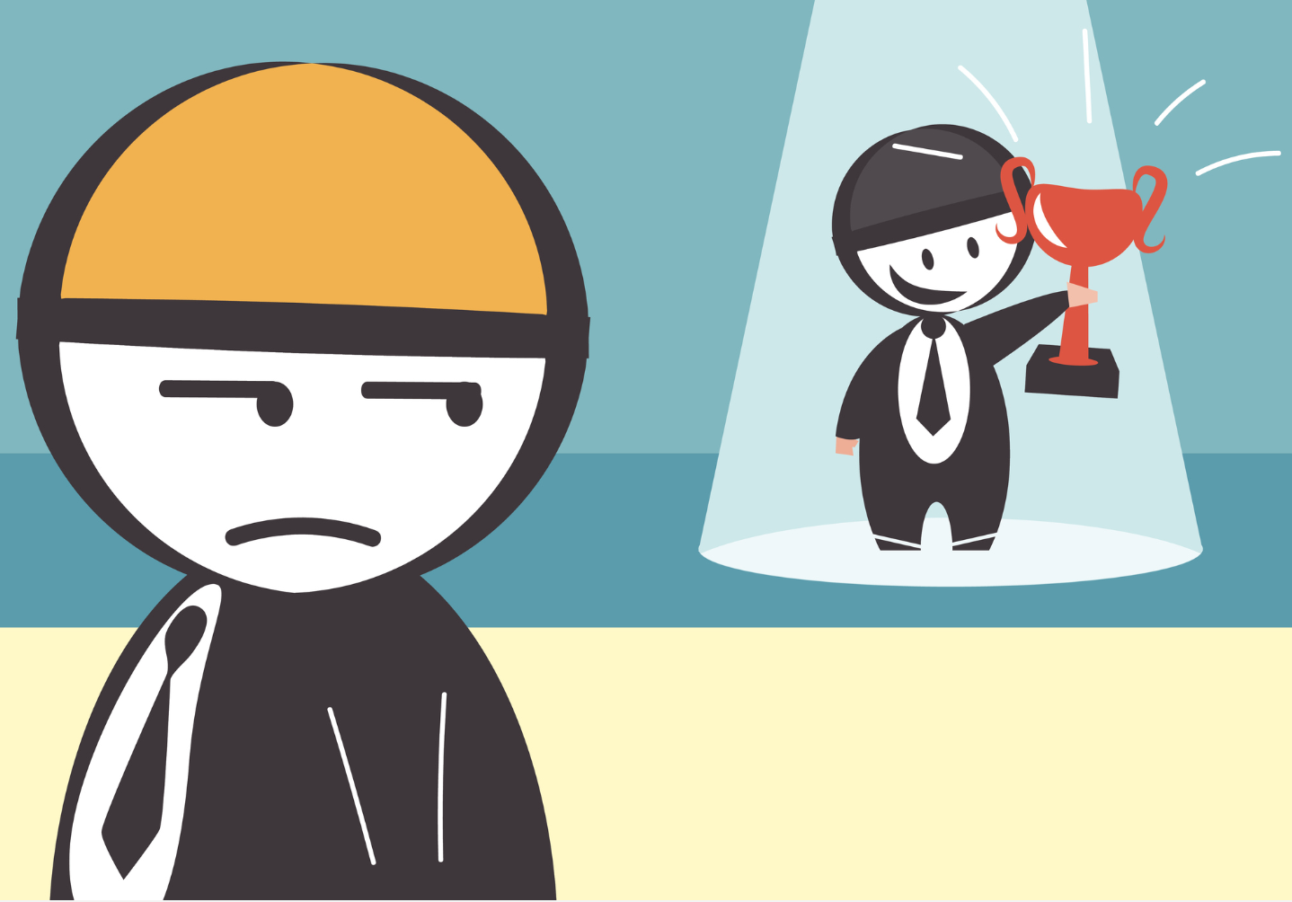
ENVY
Farmville

Slide 24


OWNERSHIP
Best Farm in FarmVille

Slide 25


PROGRESSION

Slide 26
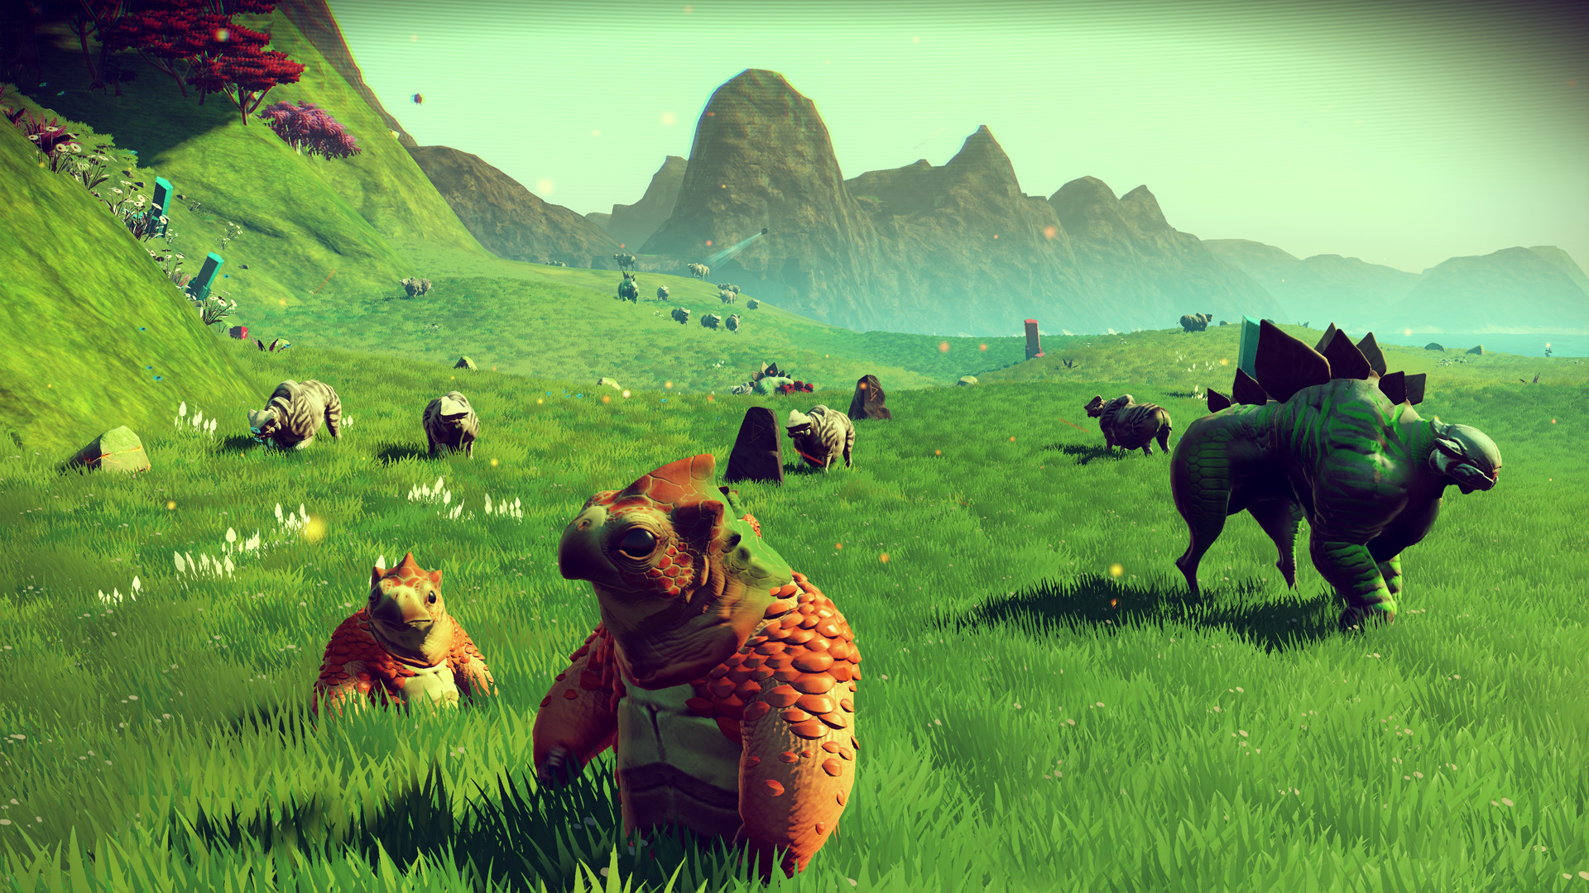
Exploration
No Man’s Sky

Slide 27
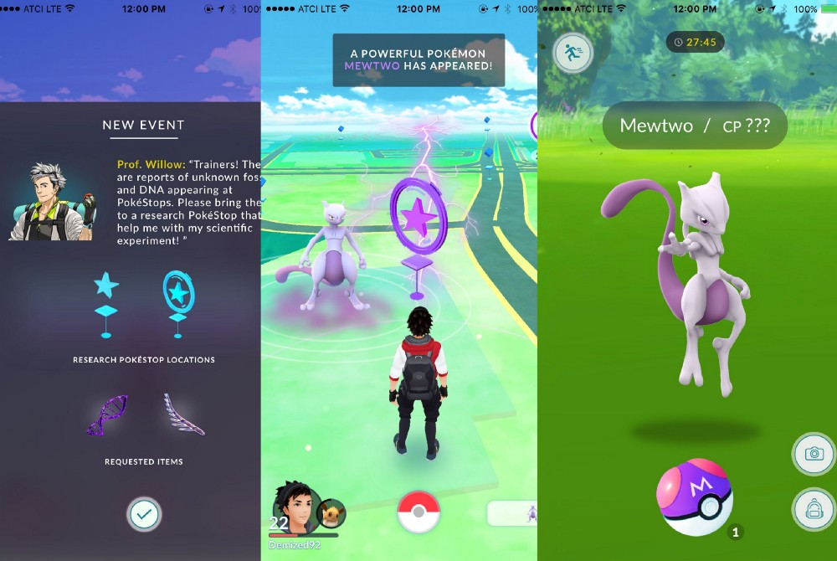
Surprise
POKEMON GO

Slide 28
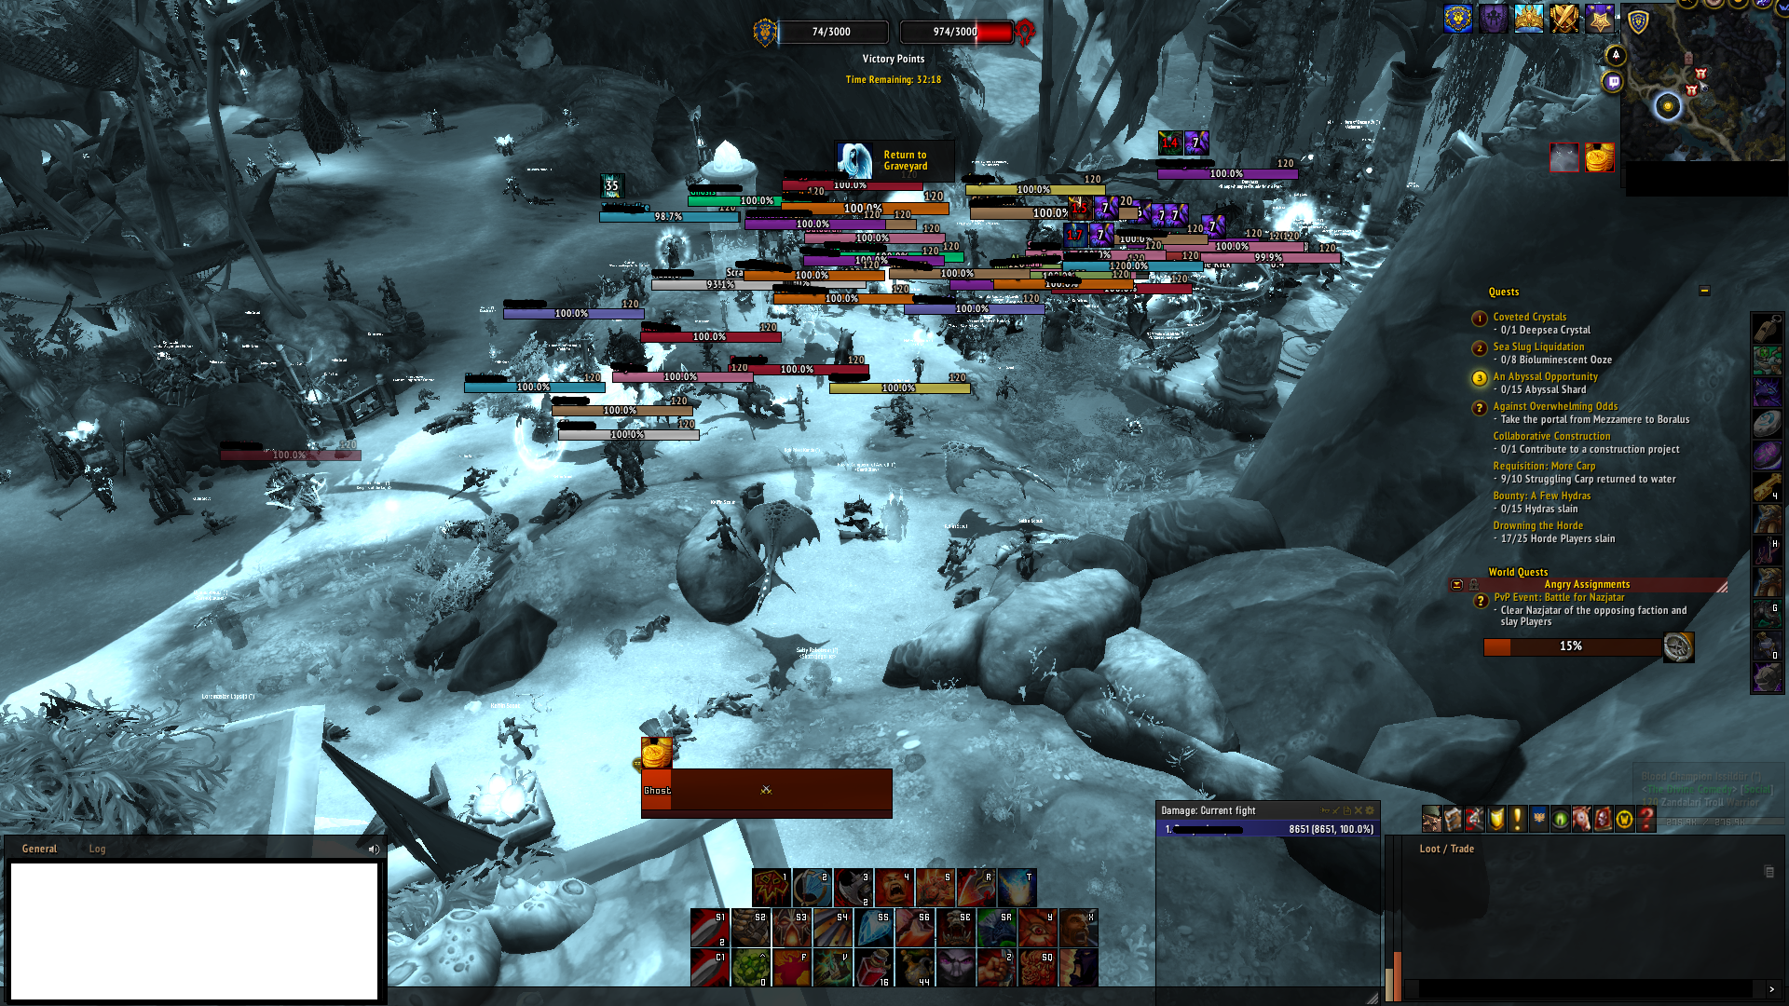
BLISSFUL PRODUCTIVITY and Collaboration
World of Warcraft

Slide 29
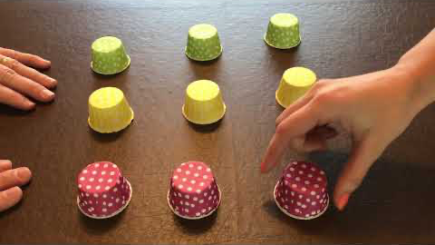
IMMERSION

Slide 30
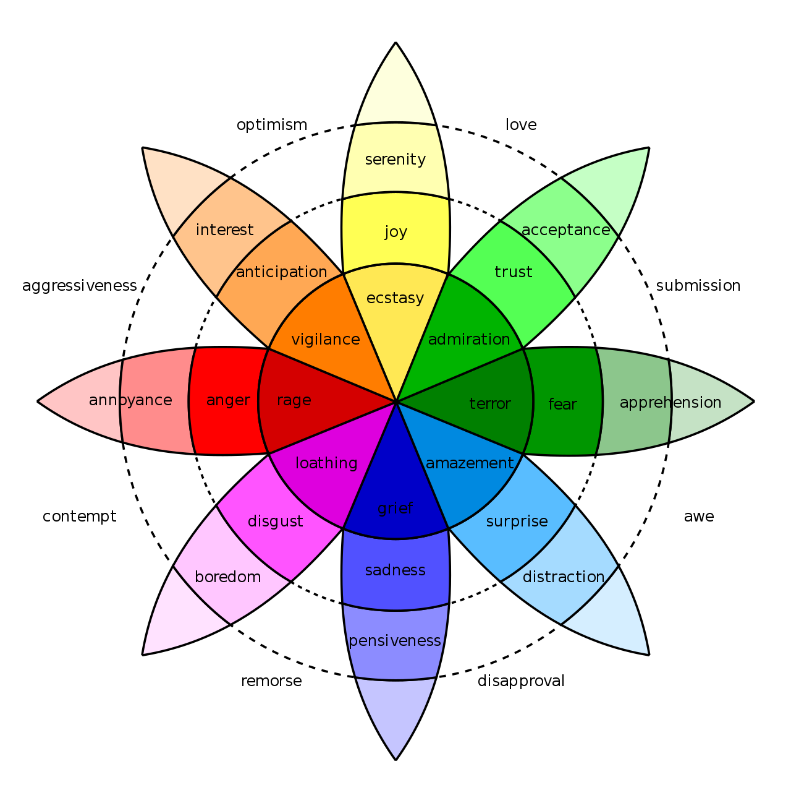
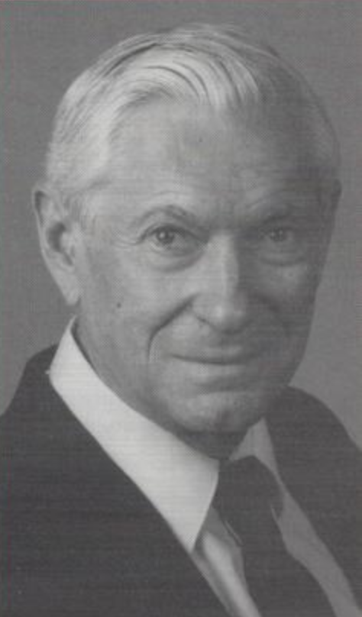
PLUTCHIK’s Wheel of emotions
Dr. Robert Plutchik
(1927 – 2006)

Slide 31



Emotions in Video games
NEGATIVE EMOTIONS
Anger / Aggression
Guilt
Bias
POSITIVE EMOTIONS
The Ideal Self
Regulating Mood
Belonging

Slide 32
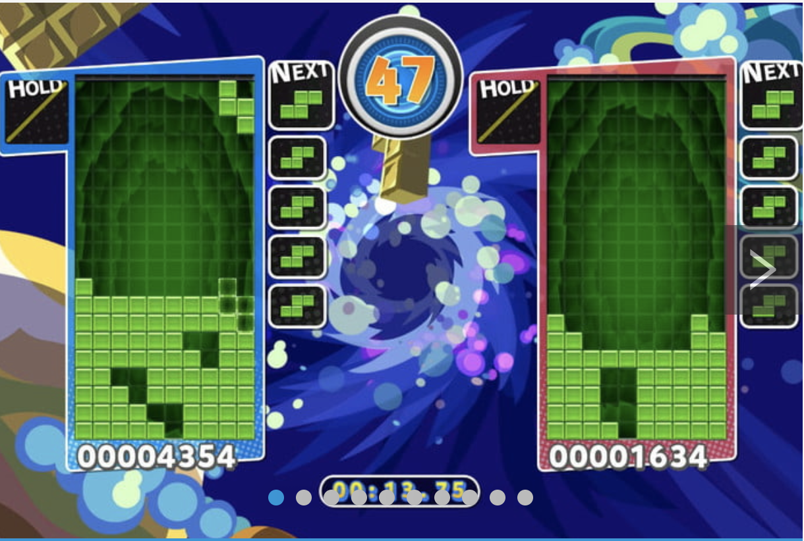


BETTER SIDE of the video games
Puzzle video games can decrease stress and improve mood.
Video games, like ‘Khan Academy Kids’ & ’ABCMouse.com’ can make learning fun.

Slide 33
Questions
Which one of the following is not a player-type?
Killers B. Achievers
C. Explorers D. Dreamers
2. Suppose you would like to build a great farm at your Farmville profile. What kind of mechanics can be used to engage you?
Progression B. Ownership
C. Status D. Collection
3. How will you define ‘Near-Misses’?
A. Intrinsic Motivation B. Extrinsic Motivation

Slide 34
Questions
Which one of the following is not a player-type?
Killers B. Achievers
C. Explorers. D. Dreamers
2. Suppose you would like to build a great farm at your Farmville profile. What kind of mechanics can be used to engage you?
Progression B. Ownership
C. Status D. Collection
3. How will you define ‘Near-Misses’?
A. Intrinsic Motivation B. Extrinsic Motivation

Slide 35
Thank You!

